Slide 1
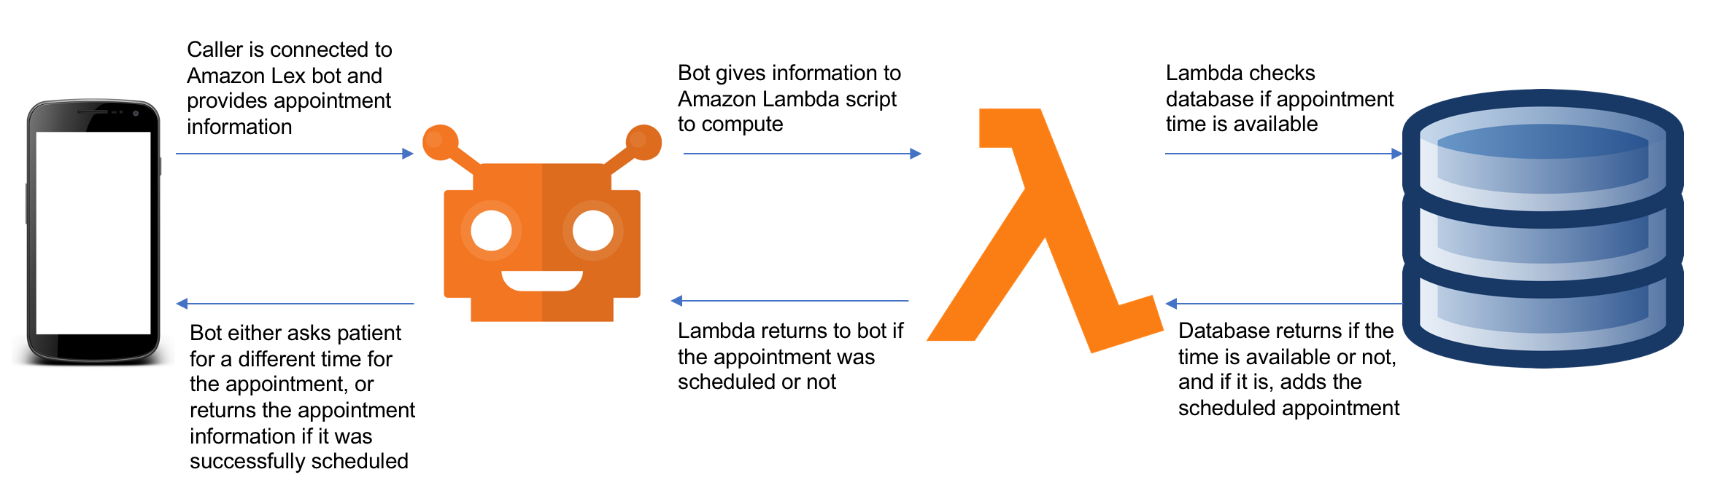
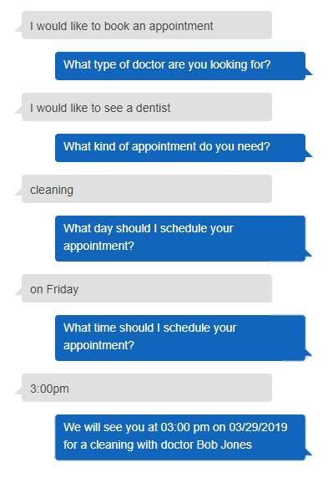







317
Envera Virtual Agent – Chat Bot
Team members: Aaron Buehne, Andy Huynh, Davis Tran | Faculty adviser: Kostadin Damevski, Ph.D | Sponsor: Envera Health | Mentor: Robert Dahlberg, Ph.D
Introduction
We want to help make calling doctor’s offices more efficient. This automated bot will answer calls for doctors and schedule appointments for the patients.
How It Works?
The virtual abgent requires several parts working together to be fully functional:
User calls the bot
Bot prompts user for needed information and stores the information
The bot analyzes information to figure out what to do
Bot checks database for availabilities and finally books the appointment
Benefits
Bot is available 24 hours a day, 7 days a week
Using a bot saves money for the health company
The bot is more efficient at scheduling appointments so it saves time
The bot provides instant answers due to its speed which results in improved customer service
Finally, if all else fails, the caller can still ask to talk to a human and the bot will connect the call to someone else.

